Slide 1


Tools for large graph mining WWW 2008 tutorial Part 2: Diffusion and cascading behavior
Jure Leskovec and Christos Faloutsos
Machine Learning Department
Joint work with: Lada Adamic, Deepay Chakrabarti, Natalie Glance, Carlos Guestrin, Bernardo Huberman, Jon Kleinberg, Andreas Krause, Mary McGlohon, Ajit Singh, and Jeanne VanBriesen.

Slide 2
Tutorial outline
Part 1: Structure and models for networks
What are properties of large graphs?
How do we model them?
Part 2: Dynamics of networks
Diffusion and cascading behavior
How do viruses and information propagate?
Part 3: Matrix tools for mining graphs
Singular value decomposition (SVD)
Random walks
Part 4: Case studies
240 million MSN instant messenger network
Graph projections: how does the web look like

Slide 3
Part 2: Outline
Diffusion and Cascading Behavior
Part 1: Basic mathematical models
Virus propagation and Diffusion (cascading behavior)
Finding influential nodes
Part 2: Empirical studies on large networks
Viral Marketing and Blogging
Part 3: More algorithms and consequences
Detecting cascades effectively
Conclusion and reflections

Slide 4
Structure vs. Process
What have we learned about large networks?
We know a lot about the structure: Many recurring patterns
Scale-free, small-world, locally clustered, bow-tie, hubs and authorities, communities, bipartite cores, network motifs, highly optimized tolerance
We know much less about processes and dynamics

Slide 5
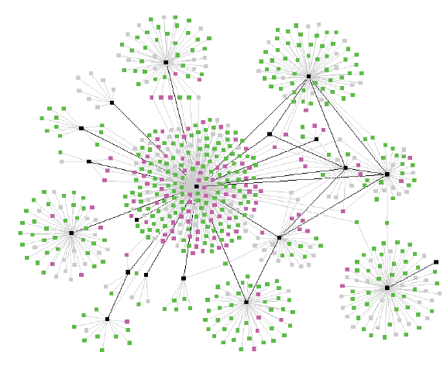
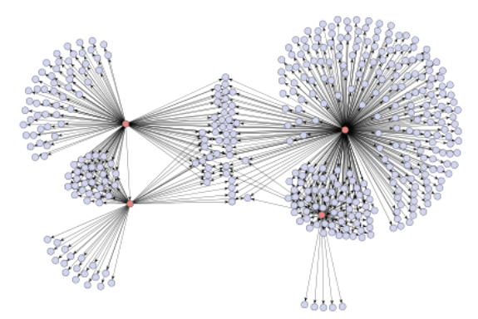
Diffusion in Social Networks
One of the networks is a spread of a disease, the other one is product recommendations
Which is which? ☺

Slide 6
Diffusion in Social Networks
A fundamental process in social networks:
Behaviors that cascade from node to node like an epidemic
News, opinions, rumors, fads, urban legends, …
Word-of-mouth effects in marketing: rise of new websites, free web based services
Virus, disease propagation
Change in social priorities: smoking, recycling
Saturation news coverage: topic diffusion among bloggers
Internet-energized political campaigns
Cascading failures in financial markets
Localized effects: riots, people walking out of a lecture

Slide 7
Empirical Studies of Diffusion (1)
Experimental studies of diffusion have long history:
Spread of new agricultural practices [Ryan-Gross 1943]
Adoption of a new hybrid-corn between the 259 farmers in Iowa
Classical study of diffusion
Interpersonal network plays important role in adoption → Diffusion is a social process
Spread of new medical practices [Coleman et al 1966]
Studied the adoption of a new drug between doctors in Illinois
Clinical studies and scientific evaluations were not sufficient to convince the doctors
It was the social power of peers that led to adoption

Slide 8
Empirical Studies of Diffusion (2)
Diffusion has many (very interesting) ☺ flavors, e.g.:
The contagion of obesity [Christakis et al. 2007]
If you have an overweight friend your chances of becoming obese increases by 57%
Psychological effects of others’ opinions, e.g.: Which line is closest in length to A? [Asch 1958]
A
B
C
D

Slide 9
Diffusion Curves (1)
Basis for models:
Probability of adopting new behavior depends on the number of friends who have adopted [Bass ‘69, Granovetter ‘78, Shelling ’78]
What’s the dependence?
Prob. of adoption
Prob. of adoption
k = number of friends adopting
k = number of friends adopting
Diminishing returns?
Critical mass?

Slide 10
Diffusion Curves (2)
Prob. of adoption
Prob. of adoption
k = number of friends adopting
k = number of friends adopting
Diminishing returns?
Critical mass?
Key issue: qualitative shape of diffusion curves
Diminishing returns? Critical mass?
Distinction has consequences for models of diffusion at population level

Slide 11
Part 1: Mathematical Models
Two flavors, two types of questions:
A) Models of Virus Propagation:
SIS: Susceptible – Infective – Susceptible (e.g., flu)
SIR: Susceptible – Infective – Recovered (e.g., chicken-pox)
Question: Will the virus take over the network?
B) Models of Diffusion:
Independent contagion model
Threshold model
Questions:
Finding influential nodes
Detecting cascades

Slide 12
A) Models of Virus Propagation
How do viruses/rumors propagate?
Will a flu-like virus linger, or will it become extinct?
(Virus) birth rate β: probability than an infected neighbor attacks
(Virus) death rate δ: probability that an infected node heals
Healthy
Prob. δ
N₂
Prob. β
N₁
N
Prob. β
Infected
N₃

Slide 13
The Model
Susceptible-Infective-Susceptible (SIS) model
Cured nodes immediately become susceptible
Virus “strength”: s = β /δ
Infected by neighbor with prob. β
Susceptible
Infective
Cured internally with prob. δ

Slide 14
Question: Epidemic Threshold τ
of a graph: the value of τ, such that
If strength s = β / δ < τ
epidemic can not happen
Thus,
given a graph
compute its epidemic threshold

Slide 15
Epidemic Threshold τ
What should τ depend on?
avg. degree? and/or highest degree?
and/or variance of degree?
and/or third moment of degree?
and/or diameter?

Slide 16
Epidemic Threshold
Theorem [Wang+ 2003]:
We have no epidemic if:
Epidemic threshold
(Virus) Death rate
β/δ < τ = 1/ λ_{1,A}
(Virus) Birth rate
largest eigenvalue
of adj. matrix A
► λ_{1,A} alone captures the property of the graph!

Slide 17
Experiments (AS graph)
10,900 nodes and 31,180 edges
β/δ > τ (above threshold)
β/δ = τ (at the threshold)
β/δ < τ (below threshold)

Slide 18
Extensions: Information Survival
Sensors gain new information
but they may die due to harsh environment or battery failure
so they occasionally try to transmit data to nearby sensors
and failed sensors are occasionally replaced.
Under what conditions does the information survive?

Slide 19
Information Survival: The Model
Each sensor is in one of 3 states
Sensor:
Dies with prob. δ
Transmits message with prob. β
Is repaired with prob. γ
Will the message/ information survive?

Slide 20
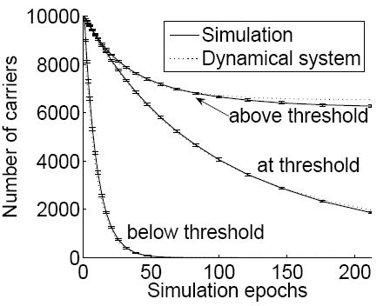
Information Survival Threshold
Theorem [Chakrabarti et al. 2007]:
If the survivability score s=|λ_{1,S}| obeys
s < 1

Slide 21
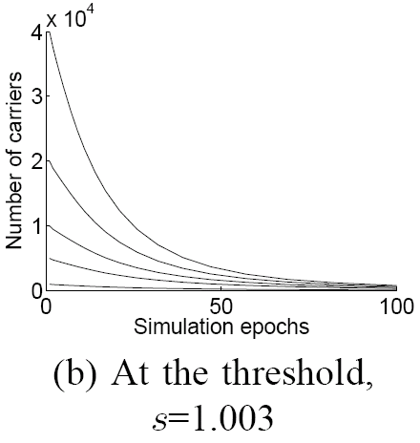
Information Survival Threshold
Does it matter how many sensors initially carry the information?

Slide 22
B) Models of Diffusion in Networks
Initially some nodes are active
Active nodes spread their influence on the other nodes, and so on …
a
d
d
b
f
f
e
h
g
c
i
c

Slide 23
Threshold Model [Granovetter ‘78]
Initially some nodes are active
Each edge (u,v) has weight w_{uv}
Each node has a threshold t
Node u activates if t < Σ_{active(u)} w_{uv}
0
0.4
.5
0.4
0.2
0.3
0.3
0.2
.8
.5
0.3
.5
0
0.2
.4
0.4
0.4
0.2
0.3
0.3
0.3
.6
.6
.4
.6
0.4
.4

Slide 24
Independent Contagion Model
Initially some nodes are active
Each edge (u,v) has probability (weight) p_{uv}
Node a becomes active: activates node b with prob. p_{uv}
Activations spread through the network
a
0.4
d
d
0.4
0.2
0.3
0.3
0.2
b
f
0.3
e
0.2
e
h
0.4
0.4
0.3
0.3
0.2
g
0.3
g
i
c
0.4
i

Slide 25
General Contagion Model
What general language do we need to describe diffusion?
[Kempe et al. ‘03, Dodds-Watts ‘04]
When u tries to influence v: success based on set of nodes S that already tried and failed
Success functions p_{v}(u,S)
S
v
u
Independent cascades: p_{v}(u,S) = p_{uv}
Threshold: if |S|=k: p_{v}(u,S)=1 else 0
Diminishing returns: p_{v}(u,S) ≥ p_{v}(u,T) if S ⊆ T

Slide 26
Most Influential Subset of Nodes
If S is initial active set, let f(S) denote expected size of final active set
Most influential set of size k: the set S of k nodes producing largest expected cascade size f(S) if activated [Domingos-Richardson 2001]
a
d
b
f
e
h
g
i
c
As a discrete optimization problem
NP-hard and highly inapproximable
Proof relies on critical mass. Is it necessary?

Slide 27
An Approximation Result
Diminishing returns: p_{v}(u,S) ≥ p_{v}(u,T) if S ⊆ T
Hill-climbing: repeatedly select node with maximum marginal gain
Performance guarantee: hill-climbing algorithm is within (1-1/e) ~63% of optimal [Kempe et al. 2003]

Slide 28
An Approximation Result
Analysis: diminishing returns at individual nodes implies diminishing returns at a “global” level
Cascade size f(S) grows slower and slower with S.
f is submodular: if S ⊆ T then
f(S∪ {x}) – f(S) ≥ f(T∪ {x}) – f(T)
Theorem [Nehmhauser et al. ‘78]: If f is a function that is monotone and submodular, then k-step hill-climbing produces set S for which f(S) is within (1-1/e) of optimal.

Slide 29
Analysis: Independent Contagion
Our function f is clearly monotone; we must show that it is submodular:
f(S∪ {x}) – f(S) ≥ f(T∪ {x}) – f(T)
What do we know about submodular functions?
1) If f₁, f₂, …, f_{k} are submodular, and a₁, a₂, … a_{k} > 0 then ∑a_{i} f_{i} is also submodular
2) Natural example:
Sets A₁, A₂, …, A_{n}:
f(S) = size of union of A_{i}
T
S
x

Slide 30
Analysis: Alternative View
a
0.4
d
Alternative view:
Generate the randomness ahead of time
0.4
0.2
0.3
0.3
0.2
b
f
0.3
0.2
e
h
0.4
0.4
0.3
0.3
0.2
g
0.3
c
0.4
i
Flip a coin for each edge to decide whether it will succeed when (if ever) it attempts to transmit
Edges on which activation will succeed are live
f(S) = size of the set reachable by live-edge paths

Slide 31
Analysis: Alternative View
a
0.4
d
Fix outcome i of coin flips
Let f_{i}(S) be size of cascade from S given these coin flips
0.4
0.2
0.3
0.3
0.2
b
f
0.3
0.2
e
h
0.4
0.4
0.3
0.3
0.2
g
0.3
c
0.4
i
Let R_{i}(v) = set of nodes reachable from v on live-edge paths
f_{i}(S) = size of union R_{i}(v) → f_{i} is submodular
f = ∑ Prob[i] f_{i} → f is submodular

Slide 32
Part 2: Empirical Analysis
What do diffusion curves look like?
How do cascades look like?
Challenge:
Large dataset where diffusion can be observed
Need social network links and behaviors that spread
We use:
Blogs: How information propagates? [Leskovec et al. 2007]
Product recommendations: How recommendations and purchases propagate? [Leskovec-Adamic-Huberman 2006]
Communities: How community membership propagates? [Backstrom et al. 2006]

Slide 33
Diffusion in Blogs
Posts
Blogs
Information cascade
Time ordered hyperlinks
Data – Blogs:
We crawled 45,000 blogs for 1 year
10 million posts and 350,000 cascades
Notes:
J: Make the animation

Slide 34


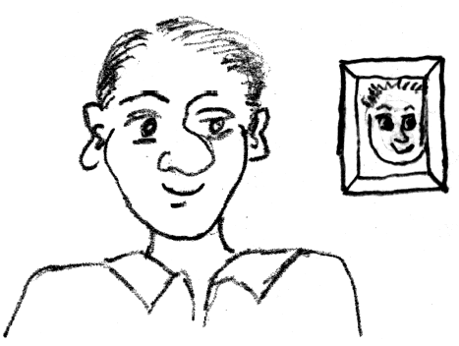
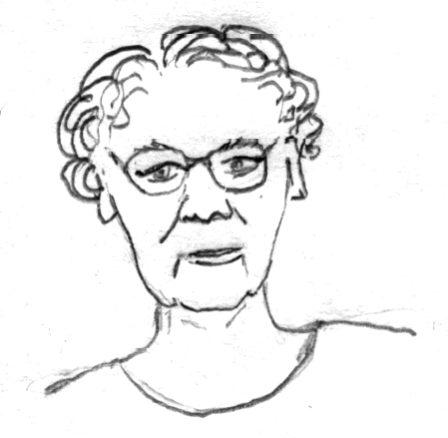
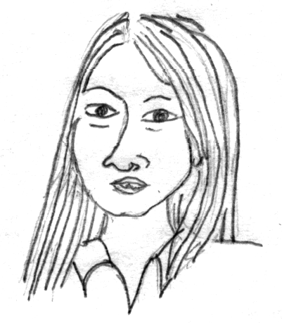
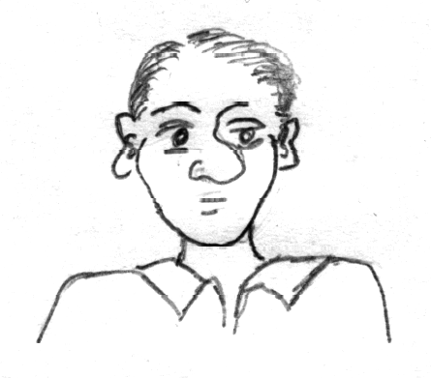
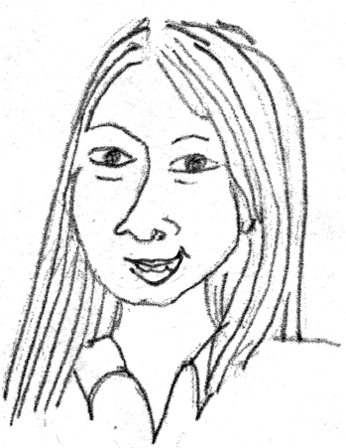
Diffusion in Viral Marketing
Senders and followers of recommendations receive discounts on products
10% credit
10% off
Data – Incentivized Viral Marketing program
16 million recommendations
4 million people
500,000 products

Slide 35
Diffusion of Community Membership
Use social networks where people belong to explicitly defined groups
Each group defines a behavior that diffuses
Data – LiveJournal:
On-line blogging community with friendship links and user-defined groups
Over a million users update content each month
Over 250,000 groups to join

Slide 36
How do diffusion curves look like?
Viral marketing – DVD purchases:
Mainly diminishing returns (saturation)
Turns upward for k = 0, 1, 2, …
k (number of in-recommendations)

Slide 37
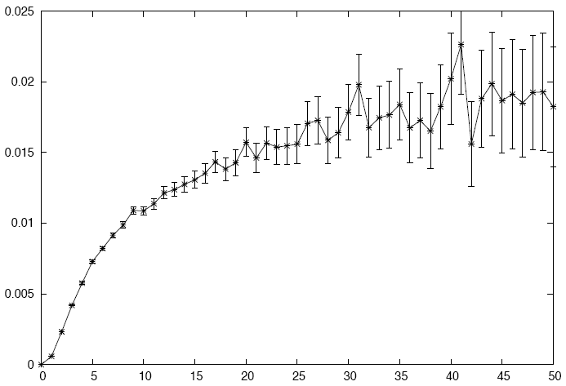
How do diffusion curves look like?
LiveJournal community membership:
Prob. of joining
k (number of friends in the community)

Slide 38
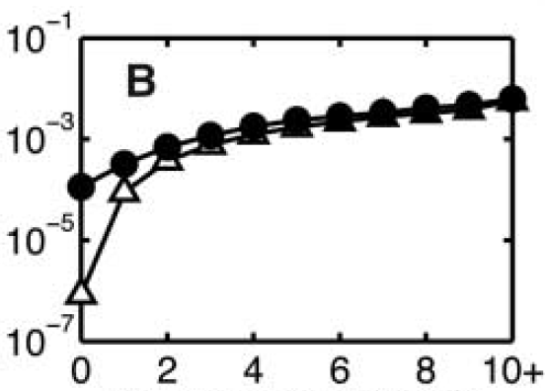
How do diffusion curves look like?
Email probability [Kossinets-Watts 2006]:
Email network of large university
Prob. of a link as a function of # of common friends
Prob. of email
k (number of common friends)

Slide 39
What are we really measuring?
For viral marketing:
We see that node v receiving the i-th recommendation and then purchased the product
For communities:
At time t we see the behavior of node v’s friends
Questions:
When did v become aware of recommendations or friends’ behavior?
When did it translate into a decision by v to act?
How long after this decision did v act?

Slide 40
More subtle features: Communities
Dependence on number of friends
Consider: connectedness of friends
x and y have three friends in the group
x’s friends are independent
y’s friends are all connected
Who is more likely to join?
x
y

Slide 41
Connectedness of Friends
Competing sociological theories
Information argument [Granovetter ‘73]
Social capital argument [Coleman ’88]
Information argument:
Unconnected friends give independent support
Social capital argument:
Safety/truest advantage in having friends who know each other
x
y

Slide 42
Connectedness of Friends
In LiveJournal, community joining probability increases with more connections among friends in group
Number and connectedness of friends are most crucial features when formulated as prediction task

Slide 43
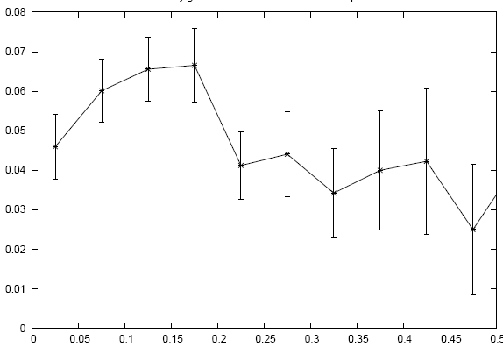
A Puzzle
If connectedness among friends promotes joining, do highly “clustered” groups grow more quickly?
Define clustering = # triangles / # open triads
Look at growth from t₁ to t₂ as a function of clustering
Groups with large clustering grow slower
But not just because clustered groups had fewer nodes one step away
growth
clustering

Slide 44
More subtle features: Viral marketing
Does sending more recommendations influence more purchases?

Slide 45
More subtle features: Viral marketing
What is the effectiveness of subsequent recommendations?

Slide 46
More subtle features: Viral marketing
What role does the product category play? [Leskovec-Adamic-Huberman 2006]
 | products | customers | recommenda-tions | edges | buy + get discount | buy + no discount
Book | 103,161 | 2,863,977 | 5,741,611 | 2,097,809 | 65,344 | 17,769
DVD | 19,829 | 805,285 | 8,180,393 | 962,341 | 17,232 | 58,189
Music | 393,598 | 794,148 | 1,443,847 | 585,738 | 7,837 | 2,739
Video | 26,131 | 239,583 | 280,270 | 160,683 | 909 | 467
Full | 542,719 | 3,943,084 | 15,646,121 | 3,153,676 | 91,322 | 79,164
people
recommendations
high
low

Slide 47
Cascading of Recommendations
Some products are easier to recommend than others
product category | number of buy bits | forward recommendations | percent
Book | 65,391 | 15,769 | 24.2
DVD | 16,459 | 7,336 | 44.6
Music | 7,843 | 1,824 | 23.3
Video | 909 | 250 | 27.6
Total | 90,602 | 25,179 | 27.8

Slide 48
Viral Marketing: More subtleties
47,000 customers responsible for the 2.5 out of 16 million recommendations in the system
29% success rate per recommender of an anime DVD
Giant component covers 19% of the nodes
Overall, recommendations for DVDs are more likely to result in a purchase (7%), but the anime community stands out

Slide 49
Predicting recommendation success
Variable | transformation | Coefficient
const |  | -0.940 ***
# recommendations | ln(r) | 0.426 ***
# senders | ln(n_{s}) | -0.782 ***
# recipients | ln(n_{r}) | -1.307 ***
product price | ln(p) | 0.128 ***
# reviews | ln(v) | -0.011 ***
avg. rating | ln(t) | -0.027 *
R² |  | 0.74
significance at the 0.01 (***), 0.05 (**) and 0.1 (*) levels

Slide 50
Viral Marketing: Why?
Viral marketing successfully utilizes social networks for adoption of some services
Hotmail gains 18 million users in 12 months, spending only $50,000 on traditional advertising
GMail rapidly gains users although referrals are the only way to sign up
Customers becoming less susceptible to mass marketing
Mass marketing impractical for unprecedented variety of products online
Google AdSense helps sellers reach buyers with targeted advertising
But how do buyers get good recommendations?

Slide 51
How do people get recommendations?
> 50% of people do research online before purchasing electronics
Personalized recommendations based on prior purchase patterns and ratings
Amazon, “people who bought x also bought y”
MovieLens, “based on ratings of users like you…”
Is there still room for viral marketing?

Slide 52
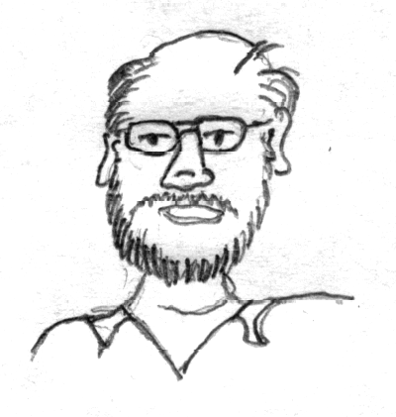
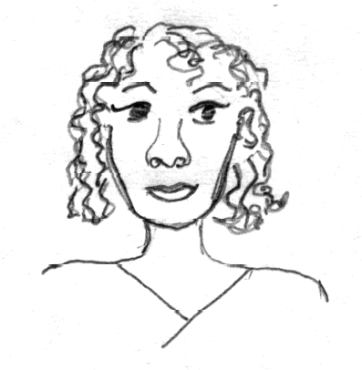
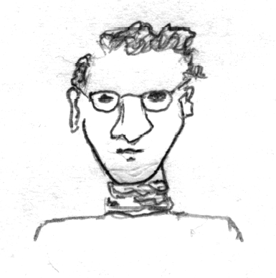
Is there still room for Viral Marketing?
We are more influenced by our friends than strangers
68% of consumers consult friends and family before purchasing home electronics (Burke 2003)

Slide 53
Viral Marketing: Not spreading virally
94% of users make first recommendation without having received one previously
Size of giant connected component increases from 1% to 2.5% of the network (100,420 users) – small!
Some sub-communities are better connected
24% out of 18,000 users for westerns on DVD
26% of 25,000 for classics on DVD
19% of 47,000 for anime (Japanese animated film) on DVD
Others are just as disconnected
3% of 180,000 home and gardening
2-7% for children’s and fitness DVDs

Slide 54
Viral Marketing: Consequences
Products suited for Viral Marketing
small and tightly knit community
few reviews, senders, and recipients
but sending more recommendations helps
pricey products
rating doesn’t play as much of a role
Observations for future diffusion models
purchase decision more complex than threshold or simple infection
influence saturates as the number of contacts expands
links user effectiveness if they are overused
Conditions for successful recommendations
professional and organizational contexts
discounts on expensive items
small, tightly knit communities

Slide 55
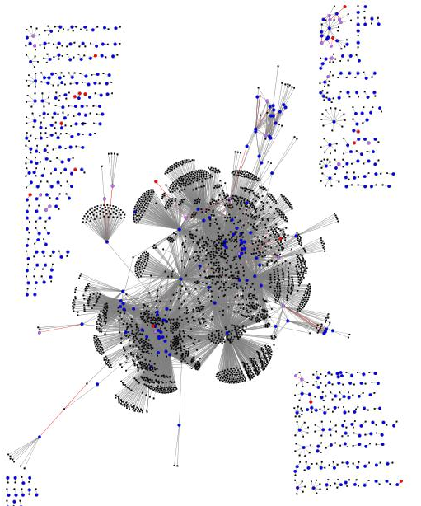
How Do Cascades Look Like?
How big are cascades?
What are the building blocks of cascades?
Medical guide book
DVD

Slide 56
Cascades as Graphs
Given a (social) network
A process by spreading over the network creates a graph (a tree)
Cascade
(propagation graph)
Social network
Let’s count cascades

Slide 57
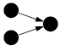
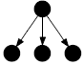
Viral Marketing: Frequent Cascades
is the most common cascade subgraph
It accounts for ~75% cascades in books, CD and VHS, only 12% of DVD cascades
is 6 (1.2 for DVD) times more frequent than
For DVDs is more frequent than
Chains ( ) are more frequent than
is more frequent than a collision ( ) (but collision has less edges)
Late split ( ) is more frequent than

Slide 58
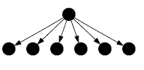
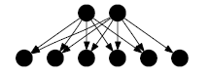
Viral Marketing Cascades
Stars (“no propagation”)
Bipartite cores (“common friends”)
Nodes having same friends
A complicated cascade

Slide 59
Information Cascades in Blogs
Cascade shapes (ordered by frequency)
Cascades are mainly stars (trees)
Interesting relation between the cascade frequency and structure

Slide 60
Cascades: Shape and Frequency
How do the
social context
the cascade shape and
frequency
relate?
What are characteristics that determine cascade frequency?
Why is it the case that
is more frequent than
is more frequent than

Slide 61
Cascade Size: Viral Marketing – Books
steep drop-off
books
10
6
-4.98
= 1.8e6 x
10
4
Count
2
very few large cascades
10
10
0
10
0
10
1
10
2
x = Cascade size (number of nodes)

Slide 62
Cascade Size: Viral Marketing – DVDs
DVD cascades can grow large
Possibly as a result of websites where people sign up to exchange recommendations
shallow drop off – fat tail
~ x
-1.56
10
4
Count
2
a number of large cascades
10
10
0
10
0
10
1
10
2
10
3
x = Cascade size (number of nodes)

Slide 63
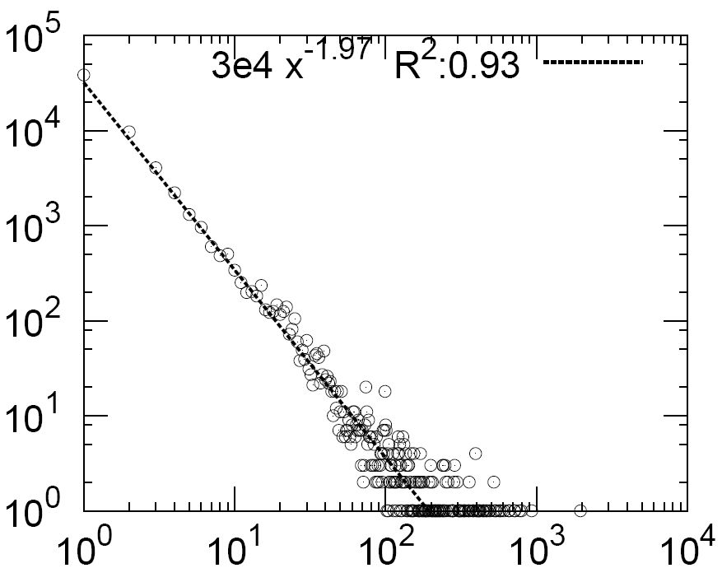
Cascade Size: Blogs
Count
x = Cascade size (number of nodes)
The probability of observing a cascade on x nodes follows a Zipf distribution: p(x) ~ x⁻²

Slide 64
Cascade Size: Consequences
Cascade sizes follow a heavy-tailed distribution
Viral marketing:
Books: steep drop-off: power-law exponent -5
DVDs: larger cascades: exponent -1.5
Blogs:
Zipf’s law: power-law exponent -2
However, it is not a branching process
A simple branching process (a on k-ary tree):
Every node infects each of k of its neighbors with prob. p
gives exponential cascade size distribution
Questions:
What role does the underlying social network play?
Can make a step towards more realistic cascade generation (propagation) model?

Slide 65
Towards a Better Cascade Model
1) Randomly pick blog to infect, add to cascade.
2) Infect each in-linked neighbor with probability β.
1
B₁
B₂
1
1
B₁
B₁
1
B₂
B₁
1
2
1
2
1
B₃
B₄
3
1
B₃
B₄
3
3) Add infected neighbors to cascade.
4) Set node infected in (i) to uninfected.
1
1
B₁
1
B₂
B₁
1
B₂
1
B₁
B₁
2
1
2
1
B₃
3
B₄
B₄
B₄
1
B₃
B₄
3

Slide 66
Cascade Model: Results
Generative model produces realistic cascades
β=0.025
Count
Count
Cascade size
Cascade node in-degree
Count
Count
Most frequent cascades
Size of star cascade
Size of chain cascade

Slide 67
Part 3: Detecting Cascades, Outbreaks
[Leskovec, Krause, Guestrin, Faloutsos, Glance, VanBriesen 2007]:
Given
a network
and a set of cascades
Which nodes shall we monitor to detect cascades (outbreaks) effectively?

Slide 68
Scenario 1: Water Network
Given a real city water distribution network
And data on how contaminants spread in the network
Problem posed by US Environmental Protection Agency
On which nodes should we place sensors to efficiently detect the all possible contaminations?
S
S

Slide 69
Scenario 2: Cascades in Blogs
Posts
Which blogs should one read to detect cascades as effectively as possible?
Blogs
Time ordered hyperlinks
Information cascade
Notes:
J: Make the animation

Slide 70
Cascade Detection: General Problem
Given a dynamic process spreading over the network
We want to select a set of nodes to detect the process effectively
Note:
The problem is different from selecting “influential nodes”
We aim to select nodes that are most easily influenced, i.e., cascades (outbreaks) hit them soon
Many other applications:
Epidemics
Network security

Slide 71
Two Parts to the Problem
Reward, e.g.:
1) Minimize time to detection
2) Maximize number of detected propagations
3) Minimize number of infected people
Cost (location dependent):
Reading big blogs is more time consuming
Placing a sensor in a remote location is expensive

Slide 72
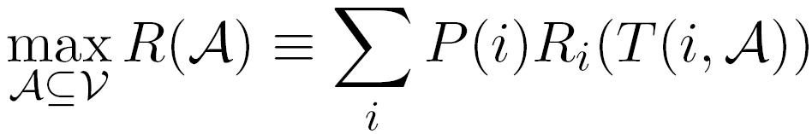
Problem Setting
S
S
Given a graph G(V,E)
and a budget B for sensors
and data on how contaminations spread over the network:
for each contamination i we know the time T(i, u) when it contaminated node u
Select a subset of nodes A that maximize the expected reward
subject to cost(A) < B
Reward for detecting contamination i

Slide 73
Structure of the Problem
Solving the problem exactly is NP-hard
Set cover (or vertex cover)
Observation:
Objective (reward) functions are submodular, i.e. diminishing returns
S₁
New sensor:
S₁
S’
S’
Adding S’ helps very little
Adding S’ helps a lot
S₃
S₂
S₂
S₄
Placement A={S₁, S₂}
Placement A={S₁, S₂, S₃, S₄}

Slide 74
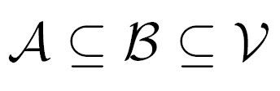
Reward Functions: Submodularity
For all placement it holds
Similar argument as in influence maximization:
Linear combinations of submodular functions are submodular:
Individual functions R_{i} are submodular:
Size of the union of sets
Benefit of adding a sensor to a small placement
Benefit of adding a sensor to a large placement
B
A
s

Slide 75
Reward Functions are Submodular
Objective functions from Battle of Water Sensor Networks competition [Ostfeld et al]:
1) Time to detection (DT)
How long does it take to detect a contamination?
2) Detection likelihood (DL)
How many contaminations do we detect?
3) Population affected (PA)
How many people drank contaminated water?
are all submodular
Notes:
We consider 3 different objective functions defined by the

Slide 76
Background: Submodular functions
What do we know about optimizing submodular functions?
A hill-climbing (i.e., greedy) is near optimal (1-1/e (~63%) of optimal)
But
1) this only works for unit cost case (each sensor/location costs the same)
2) Hill-climbing algorithm is slow
At each iteration we need to re-evaluate marginal gains
It scales as O(|V|B)
Hill-climbing
reward
a
d
b
b
a
c
e
c
d
e
Add sensor with highest marginal gain

Slide 77
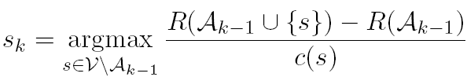
Towards a New Algorithm
Possible algorithm: hill-climbing ignoring the cost
Repeatedly select sensor with highest marginal gain
Ignore sensor cost
It always prefers more expensive sensor with reward r to a cheaper sensor with reward r-ε → For variable cost it can fail arbitrarily badly
Idea:
What if we optimize benefit-cost ratio?

Slide 78
More Problems with Benefit-Cost
Bad news: Optimizing benefit-cost ratio can fail arbitrarily badly
Example: Given a budget B, consider:
2 locations s₁ and s₂:
Costs: c(s₁)=ε, c(s₂)=B
Only 1 cascade with reward: R(s₁)=2ε, R(s₂)=B
Then benefit-cost ratio is
bc(s₁)=2 and bc(s₂)=1
So, we first select s₁ and then can not afford s₂
→We get reward 2ε instead of B
Now send ε to 0 and we get arbitrarily bad

Slide 79
Solution: CELF Algorithm
CELF (cost-effective lazy forward-selection) algorithm
A two pass greedy algorithm:
Set (solution) A: use benefit-cost greedy
Set (solution) B: use unit cost greedy
Final solution: argmax(R(A), R(B))
How far is CELF from (unknown) optimal solution?
Theorem: CELF is near optimal
CELF achieves ½(1-1/e) factor approximation
CELF is much faster than standard hill-climbing

Slide 80
Tighter Algorithmic Bound
Traditional bound (1-1/e) tells us:
How far from optimal are we even before seeing the data and running the algorithm
Can we do better? Yes!
We develop a new tighter bound. Intuition:
Marginal gains are decreasing with the solution size
We use this to get tighter bound on the solution
Notes:
That tells us how far is our solution from optimal

Slide 81
Scaling up CELF algorithm
Observation:
Submodularity guarantees that marginal benefits decrease with the solution size
Idea: exploit submodularity, doing lazy evaluations!
(considered by Robertazzi et al. for unit cost case)
reward
d

Slide 82
Scaling up CELF
CELF algorithm – hill-climbing:
Keep an ordered list of marginal benefits b_{i} from previous iteration
Re-evaluate b_{i} only for top sensor
Re-sort and prune
reward
a
d
b
b
a
c
e
c
d
e

Slide 83
Scaling up CELF
CELF algorithm – hill-climbing:
Keep an ordered list of marginal benefits b_{i} from previous iteration
Re-evaluate b_{i} only for top sensor
Re-sort and prune
reward
a
d
b
b
a
c
e
c
d
e

Slide 84
Scaling up CELF
CELF algorithm – hill-climbing:
Keep an ordered list of marginal benefits b_{i} from previous iteration
Re-evaluate b_{i} only for top sensor
Re-sort and prune
reward
a
d
b
d
a
b
e
c
e
c
Notes:
If that removes it from the top, pick next sensor
Continue until top remains unchanged

Slide 85
Experiments: 2 Case Studies
We have real propagation data
Blog network:
We crawled blogs for 1 year
We identified cascades – temporal propagation of information
Water distribution network:
Real city water distribution networks
Realistic simulator of water consumption provided by US Environmental Protection Agency

Slide 86
Case study 1: Cascades in Blogs
(Same data as in part 2 of the talk)
We crawled 45,000 blogs for 1 year
We obtained 10 million posts
And identified 350,000 cascades

Slide 87
Q1: Blogs: Solution Quality
Our bound is much tighter
13% instead of 37%
Old bound
Our bound
CELF

Slide 88
Q2: Blogs: Cost of a Blog
Unit cost:
algorithm picks large popular blogs: instapundit.com, michellemalkin.com
Variable cost:
proportional to the number of posts
We can do much better when considering costs
Variable cost
Unit cost

Slide 89
Q2: Blogs: Cost of a Blog
But then algorithm picks lots of small blogs that participate in few cascades
We pick best solution that interpolates between the costs
We can get good solutions with few blogs and few posts
Each curve represents solutions with same final reward

Slide 90
Q4: Blogs: Heuristic Selection
Heuristics perform much worse
One really needs to perform optimization

Slide 91
Blogs: Generalization to Future
We want to generalize well to future (unknown) cascades
Limiting selection to bigger blogs improves generalization

Slide 92
Q5: Blogs: Scalability
CELF runs 700 times faster than simple hill-climbing algorithm

Slide 93
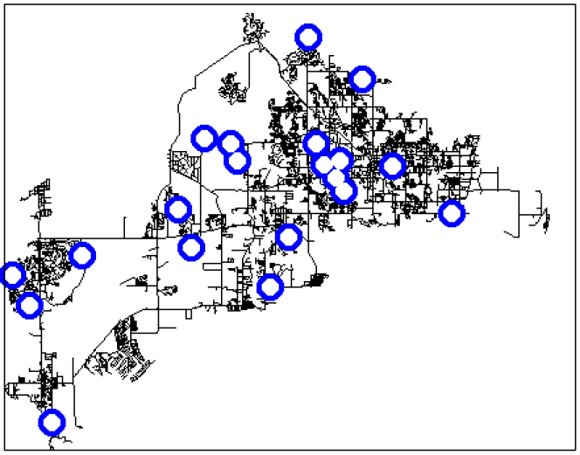
Case study 2: Water Network
Real metropolitan area water network
V = 21,000 nodes
E = 25,000 pipes
Use a cluster of 50 machines for a month
Simulate 3.6 million epidemic scenarios
(152 GB of epidemic data)
By exploiting sparsity we fit it into main memory (16GB)

Slide 94
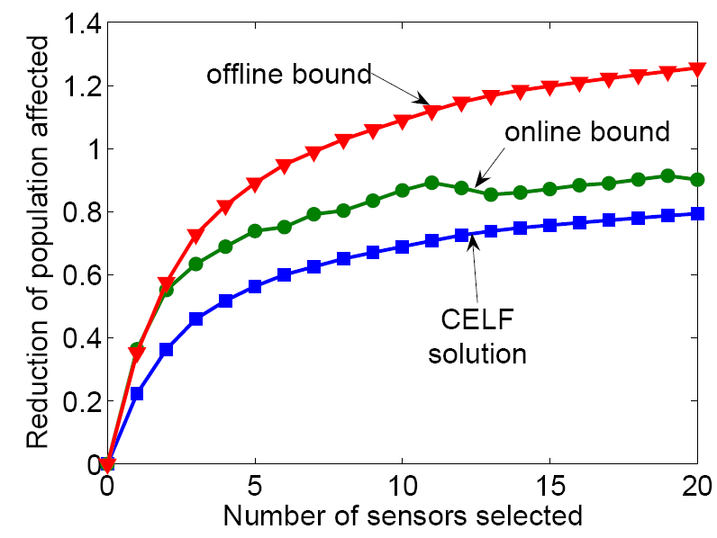
Water: Solution Quality
Old bound
Our bound
CELF
The new bound gives much better estimate of solution quality

Slide 95
Water: Heuristic Placement
Heuristics placements perform much worse
One really needs to consider the spread of epidemics

Slide 96
Water: Placement Visualization
Different reward functions give different sensor placements
Population affected
Detection likelihood

Slide 97
Water: Algorithm Scalability
CELF is an order of magnitude faster than hill-climbing

Slide 98
Conclusion and Connections
Diffusion of Topics
How news cascade through on-line networks
Do we need new notions of rank?
Incentives and Diffusion
Using diffusion in the design of on-line systems
Connections to game theory
When will one product overtake the other?

Slide 99
Further Connections
Diffusion of topics [Gruhl et al ‘04, Adar et al ‘04]:
News stories cascade through networks of bloggers
How do we track stories and rank news sources?
Recommendation incentive networks [Leskovec-Adamic-Huberman ‘07]:
How much reward is needed to make the product “work-of-mouth” success?
Query incentive networks [Kleinberg-Raghavan ‘05]:
Pose a request to neighbors; offer reward for answer
Neighbors can pass on request by offering (smaller) reward
How much reward is needed to produce an answer?

Slide 100
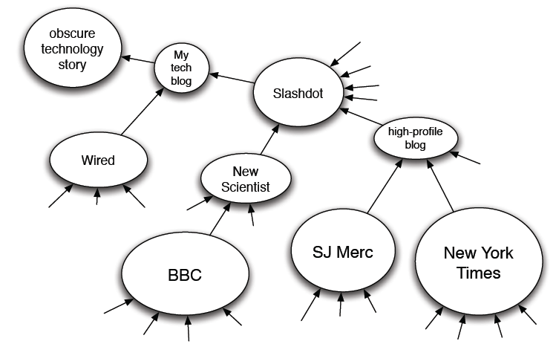
Topic Diffusion
News and discussion spreads via diffusion:
Political cascades are different than technological cascades
Suggests new ranking measures for blogs

Slide 101
Reflections
Starting to see some basic social network processes
Diffusion is a model that captures many different processes:
In the on-line world: communities, topics, popularity, commerce
Only recently have basic properties been observed on a large scale:
Confirms some social science intuitions; calls others into question
Interplay between theoretical consequences of diffusion properties and empirical studies
A number of novel opportunities:
Predictive modeling of the spread of new ideas and behaviors
Opportunity to design systems that make use of diffusion process

Slide 102
References
D. Kempe, J. Kleinberg, E. Tardos. Maximizing the Spread of Influence through a Social Network. ACM KDD, 2003.
Jure Leskovec, Lada Adamic, Bernardo Huberman. The Dynamics of Viral Marketing. ACM TWEB 2007.
Jure Leskovec, Mary McGlohon, Christos Faloutsos, Natalie Glance, Matthew Hurst. Cascading Behavior in Large Blog Graphs. SIAM Data Mining 2007.
Jure Leskovec, Ajit Singh, Jon Kleinberg. Patterns of Influence in a Recommendation Network. PAKDD 2006.
Jure Leskovec, Andreas Krause, Carlos Guestrin, Christos Faloutsos, Jeanne VanBriesen, Natalie Glance. Cost-effective Outbreak Detection in Networks. ACM KDD, 2007.
Acknowledgement
Some slides and drawings borrowed from Jon Kleinberg

Slide 103
Coming up next…
Case studies
Microsoft Instant Messenger communication network
How does the whole world communicate?
How to find fraudsters on eBay?
Graph projections
How do we predict the quality of search results without looking at the content?

